Slide 1
Real Estate Investment
Top Zip Codes in United States – 5 Year Return on Investment

Slide 2
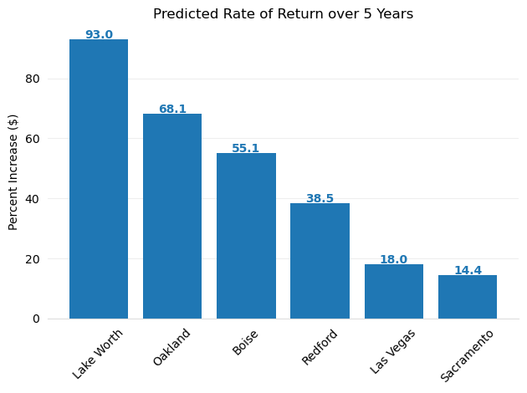
Predicted Rate of Return for zip codes with highly accurate modeling.

Slide 3
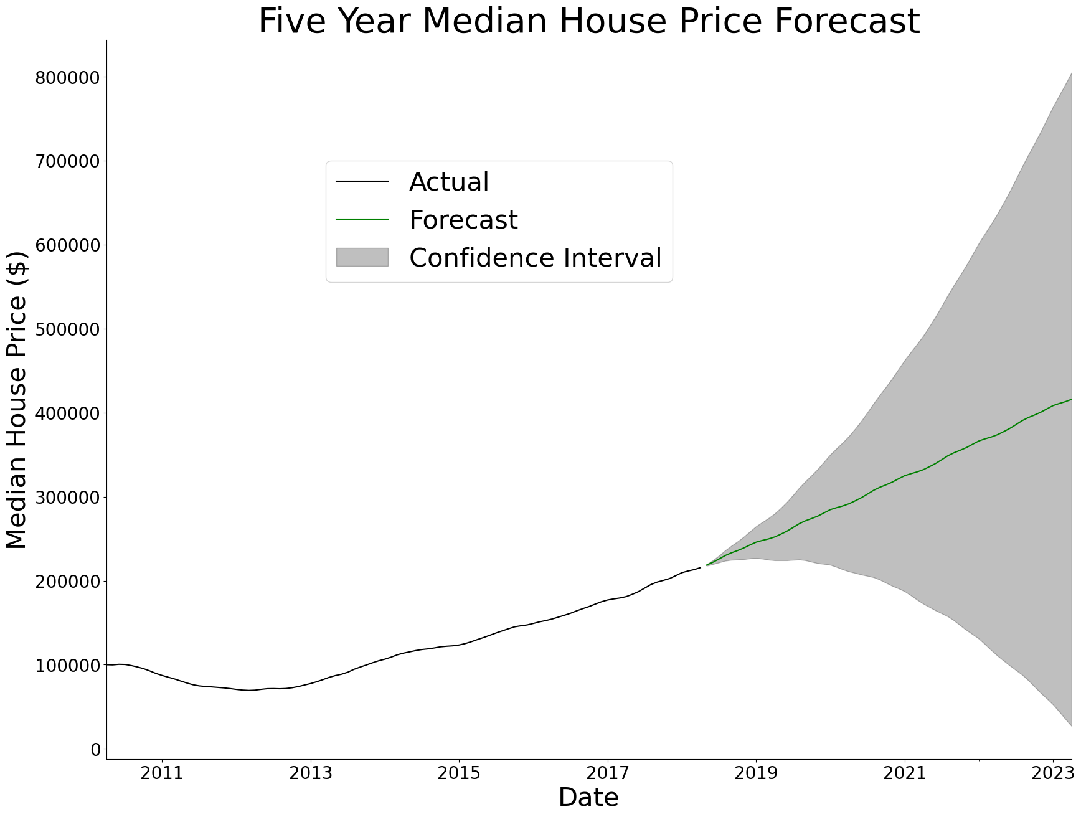
Lake Worth Forecast

Slide 4
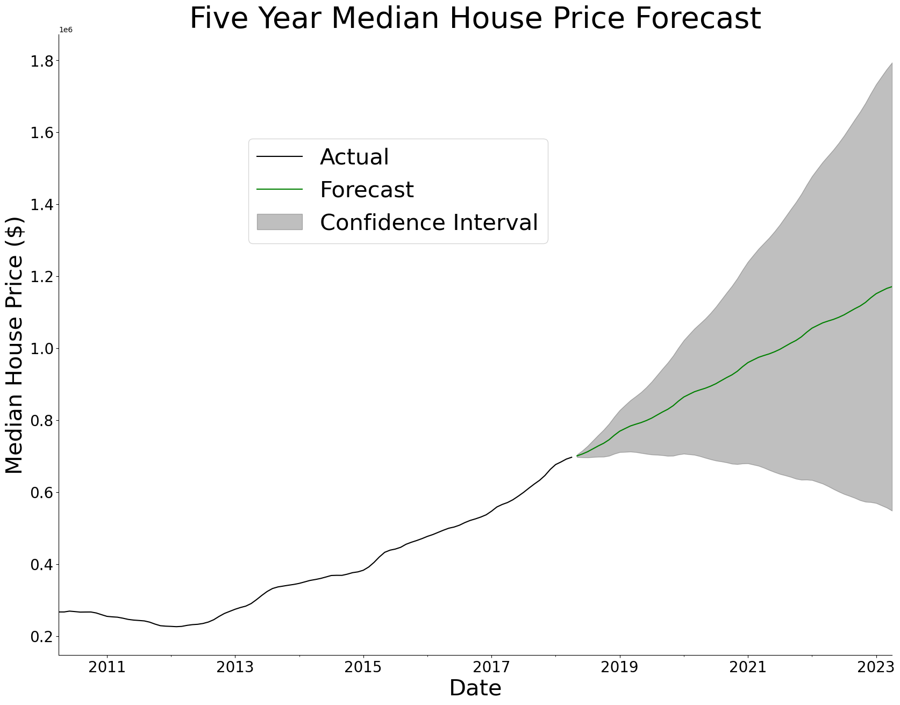
Oakland Forecast

Slide 5
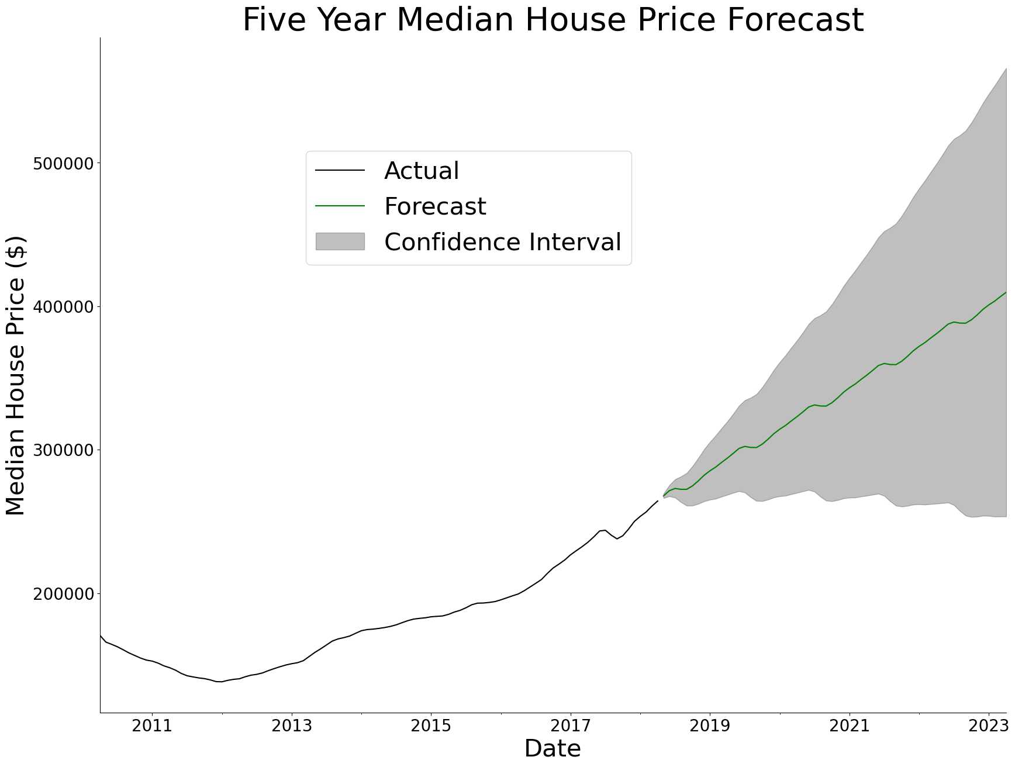
Boise Forecast

Slide 6
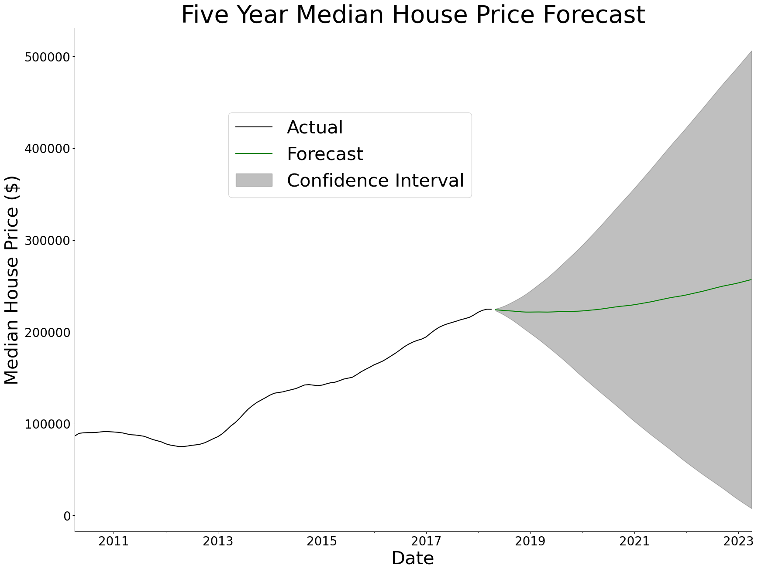
Sacramento Forecast (Non-Example)

Slide 7
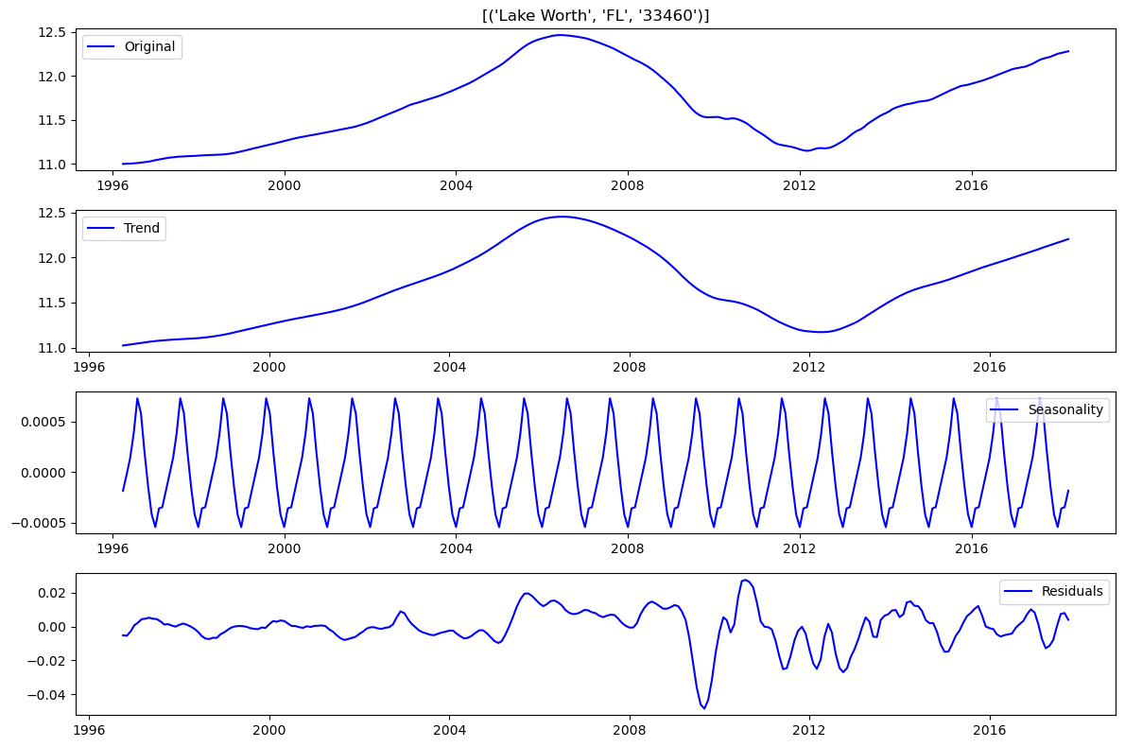
Lake Worth Seasonality
Seasonality Visual

Slide 8
Results – Oakland, California
8.1 Oakland, CA 94606
Has a predicted rate of return of 68.1% over the next 5 years (assuming we are in April of 2018 when this dataset was current)
Has the lowest margin of risk - with the lowest confidence interval value being substantially higher than the models for other zip codes.
High level of model accuracy:
Predictions within 3% of median value on average.

Slide 9
Results – Lake Worth, Florida
8.2 Lake Worth, FL 33460¶
Highest predicted return of 93.0%
Much higher risk with wide range and large negative potential for the confidence interval price at 5 years
High level of model accuracy:
Predictions within 1.3% of median value on average.

Slide 10
Results – Boise, Idaho
8.3 Boise, ID 83703
Fairly high predicted return of 55.1%
Low risk, with lowest confidence interval value being substantially higher than the models for other zip codes.
Moderate level of model accuracy:
Predictions within 8% of median value on average.

Slide 11
Q & A Time
Jim Petoskey – Data Scientist
Jim.Petoskey.146@gmail.com
Phone: (734) 649-3182
linkedin.com/in/jimpetoskey/

